Slide 1
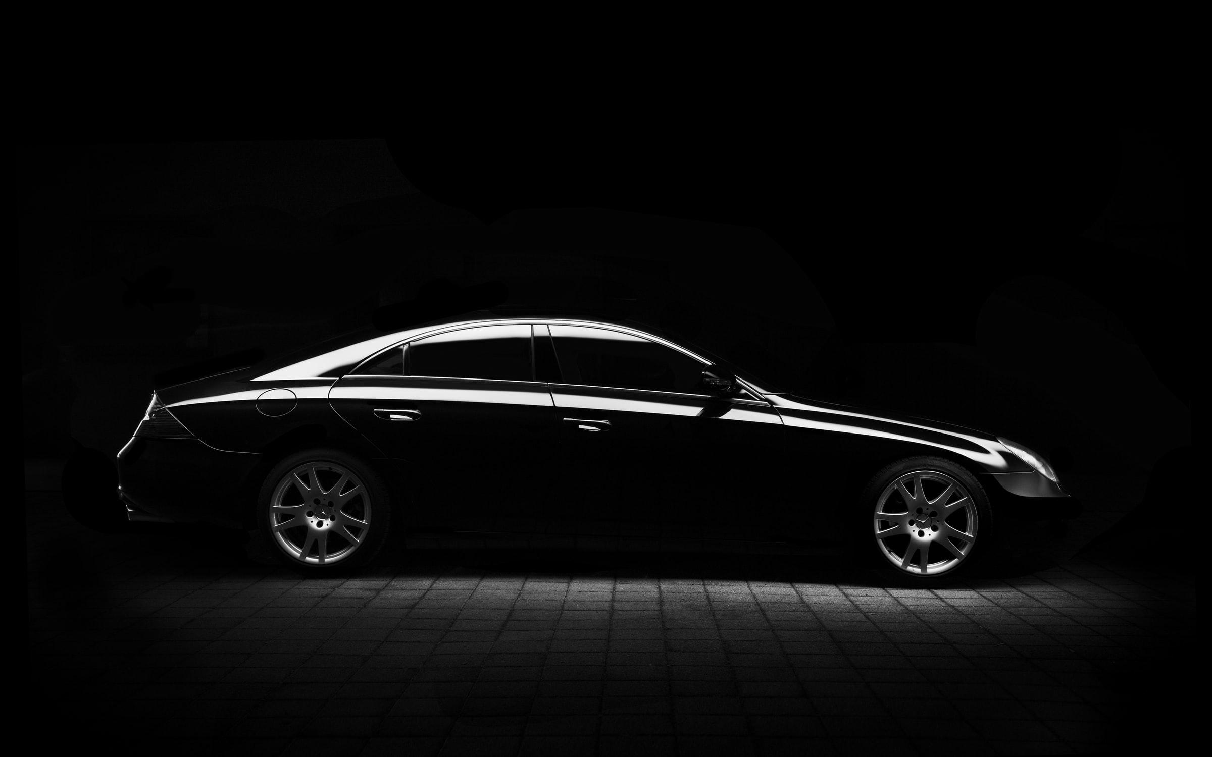
Optimizing CMG Shipments
Dennis Leo, William Siew, Grace Zhang

Slide 2
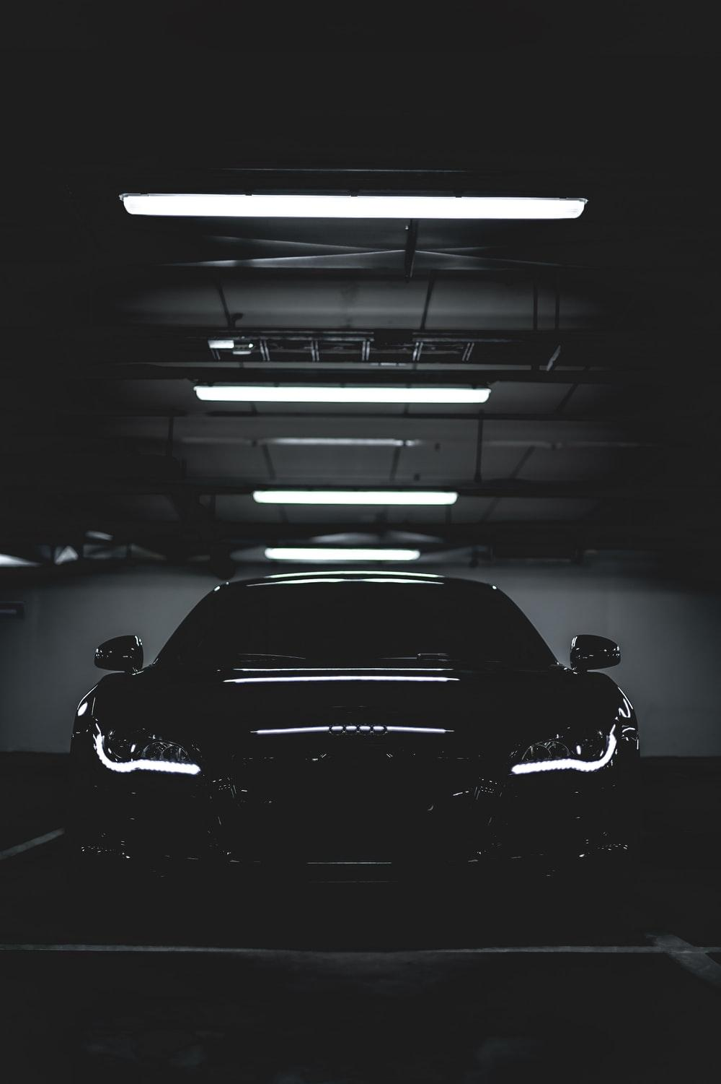
Agenda
The Challenge
Recommendations
Research Findings

Slide 3
The Challenge

Slide 4
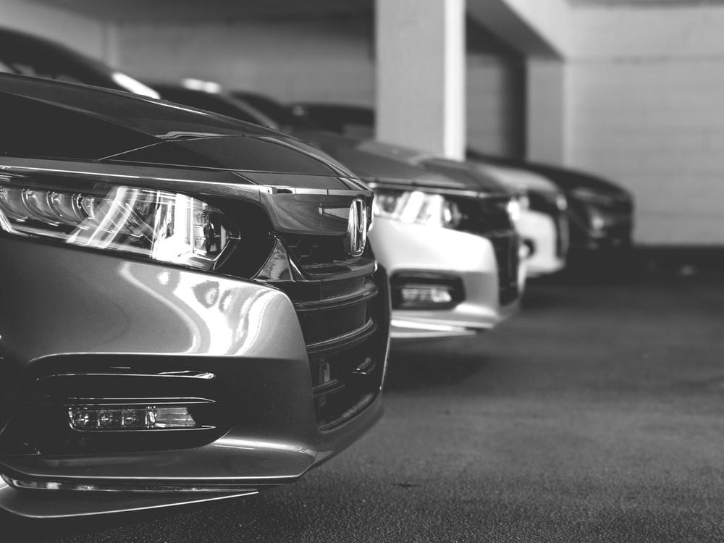
The CMG Corporation is a manufacturer of luxury cars based in Seoul, South Korea
The NY distribution center (DC) urgently needs to increase its supplies to avoid shortages
Avoiding shortages at DC’s is crucial to maintain reputation of good customer service

Slide 5
Recommendations

Slide 6



Short-Term
Strategically increase shipments along shipment lanes to meet current demand at NY DC
Partner with JMG for additional shipping lanes and Beijing manufacturer
Store excess parts at DCs to mitigate unexpected shortages
Notes:
using Figure 1, Quantitative model (Excel) to estimate best routes to maximize shipments to NY/minimize cost (on avg- 300,000 ft^3/month ~1360 ft^3/container (using avg number from google for ISO…) → 220 containers/mo * 15% growth → ~33/38 additional containers needed/month [https://www.mrbox.co.uk/shipping-containers/#:~:text=Standard%20ISO%20shipping%20containers%20are,ft%20(2.89m)%20high.]

Slide 7


Long-Term
Utilize predictive + prescriptive analytics to forecast demand
Increase transparency on lead + idle time of shipments between US DC’s
Store excess parts at DCs to mitigate unexpected shortages
Notes:
Predict demand for specific parts and differences among locations & ship more directly to where there’s more need, i.e. NY (so don’t have to ask west coast locations as often)
Store parts (across the board) at DCs in case of unexpected shortages

Slide 8
Research Findings

Slide 9
Why should we partner with JMG?
Without JMG |  | With JMG |  | Amount Saved($) w. JMG
Cumulative Capacity | Avg Cost/ Container | Cumulative Capacity | Avg Cost/ Container
40 | $2,600 | 40 | $2,600 | $0
70 | $3,150 | 70 | $3,000 | $10,500
100 | $3,400 | 100 | $3,167 | $23,333
150 (MAX) | $3,625 | 130 | $3,300 | $30,750
N/A | N/A | 160 | $3,420 | N/A
N/A | N/A | 180 | $3,566 | N/A
N/A | N/A | 210 (MAX) | $3,771 | N/A
300,000 (cubic ft/mo)
1,100 (cubic ft/container) → 272 containers per mo * 15% = ~40 additional containers/mo
Reduces overall average costs of shipments
Increases maximum capacity of NY shipments (150 → 210)
Notes:
From a cost standpoint, partnering with JMG will save you money

Slide 10

Interview Findings
Jean Carlyle
Supply Chain Manager, US Distribution
Different lead times, Order cost, holding cost, for different parts- Chris Trevino, New York Distribution Center Manager
The issue is in the ability to forecast demand, as the current process is not doing a good enough job - Chris Trevino, New York Distribution Center Manager
Half of the capacity in Seattle is currently shipped to NY (Seattle + SF on west coast- both have much smaller demand, about half of what exists in NY)
Half of the capacity in Seattle is currently shipped to NY

Slide 11
Appendix

Slide 12
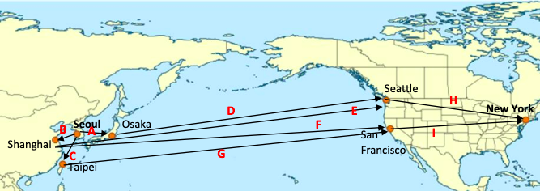
CMG Shipping Lanes

Slide 13
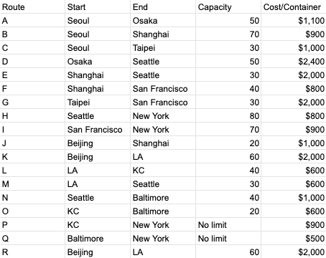
B. JMG + CMG Shipping Lanes

Slide 14
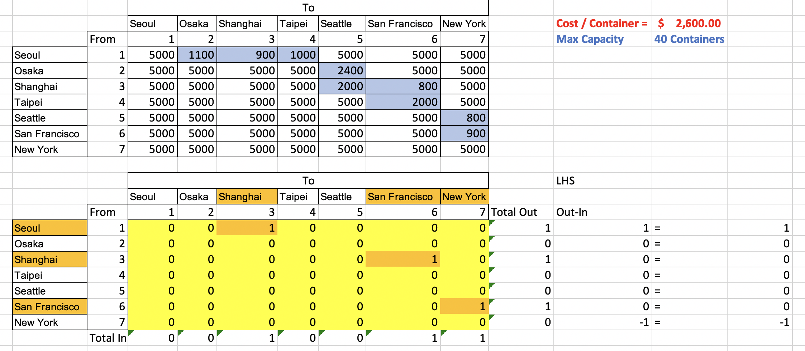
C. Risk Solver- CMG Shipping Routes (Path 1)
Notes:
Using Excel Solver

Slide 15
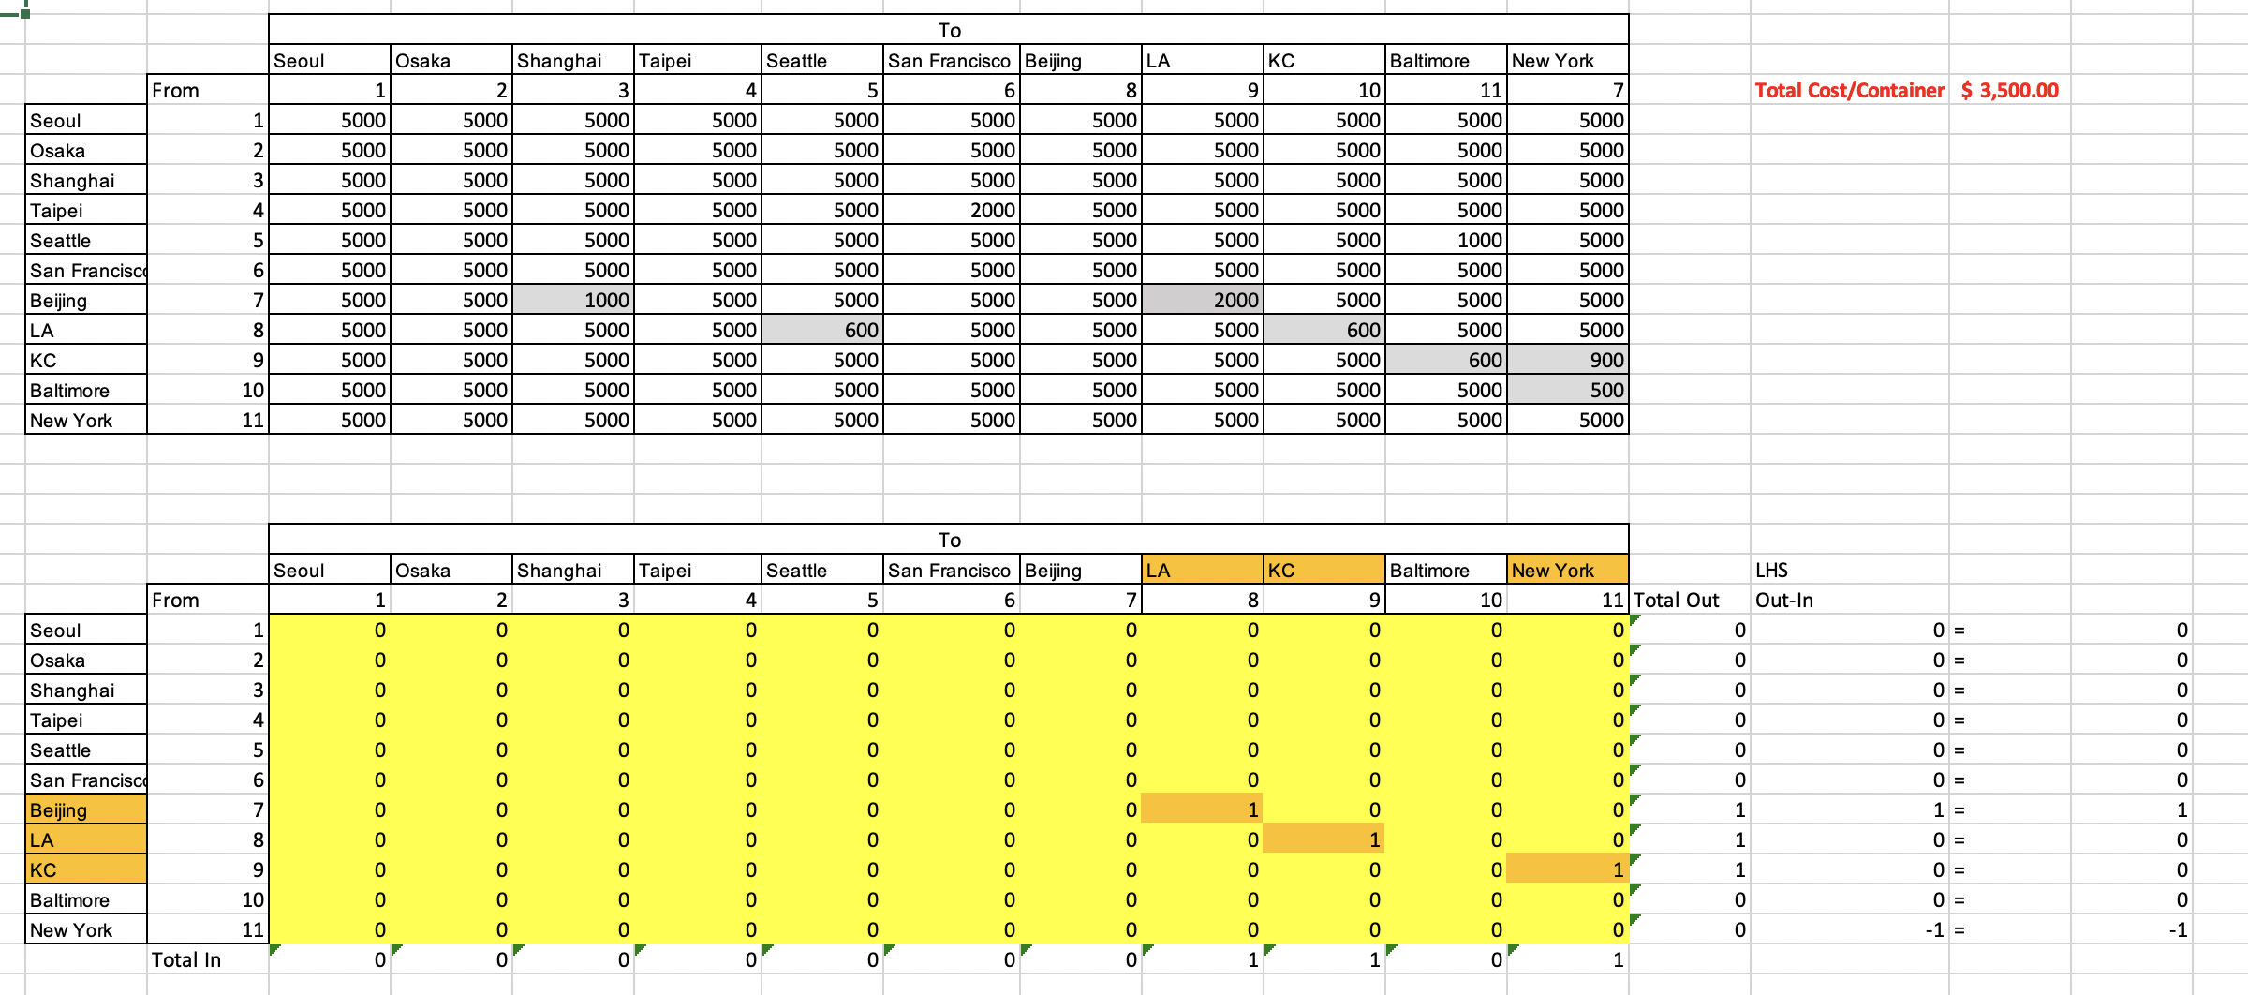
Risk Solver- CMG Shipping Routes (Path 3)

Slide 16
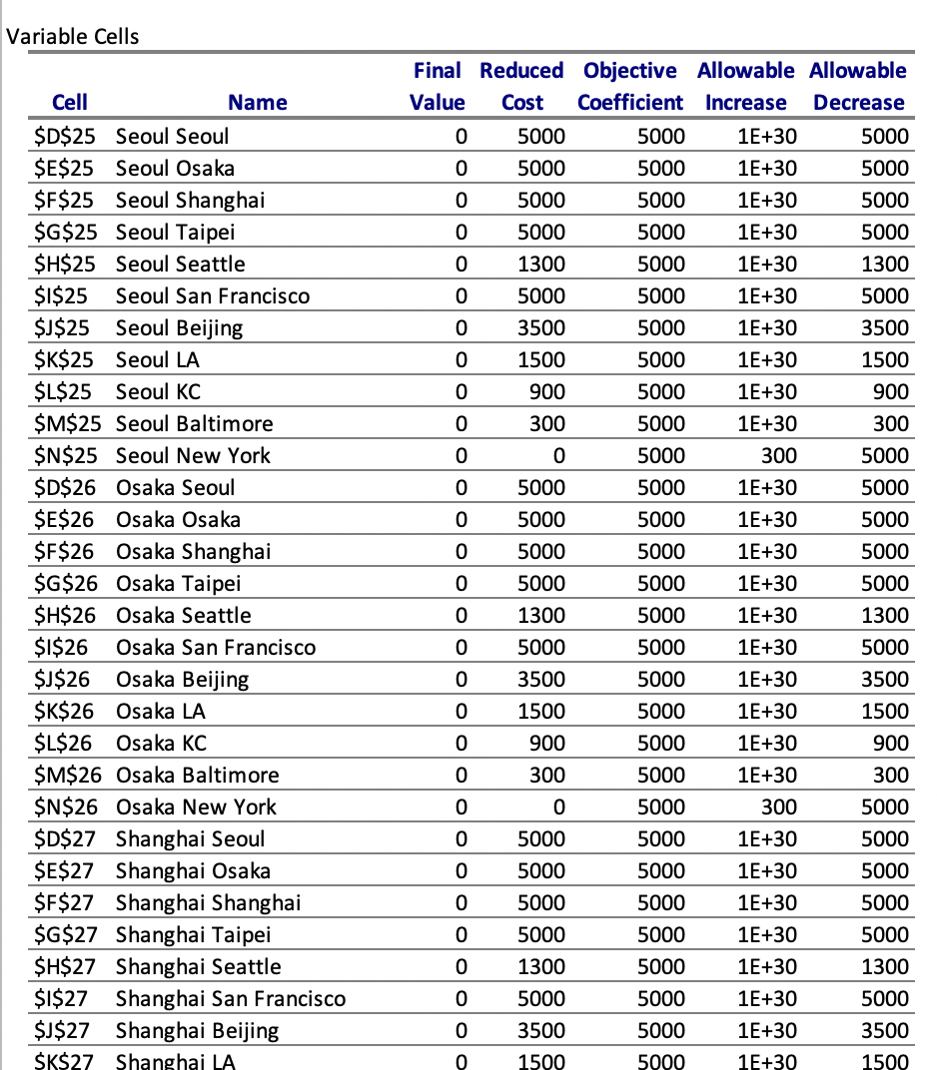
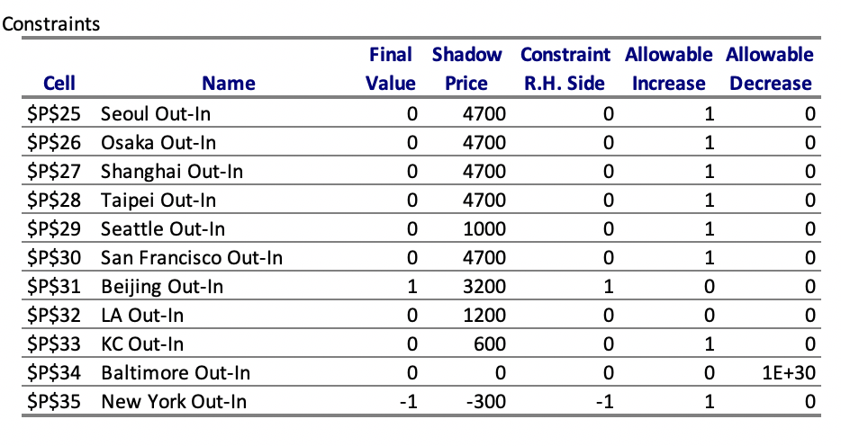
Sensitivity Report (Path 3)

Slide 17
D. Optimal Routes (Ordered, with JMG)
Path | Max. Capacity | Cost/Container
1. Seoul>Shanghai>San Francisco>New York | 40 | $2600
2. Beijing>LA>Seattle>New York | 30 | $3400
3. Beijing>LA>KC>New York | 30 | $3500
4. Seoul>Shanghai>Seattle>New York | 30 | $3700
5. Seoul>Taipei>San Francisco>New York | 30 | $3900
6. Seoul>Osaka>Seattle>New York | 20 | $4300
7. Seoul>Osaka>Seattle>Baltimore>New York | 30 | $5000
Notes:
Using Excel Solver

Slide 18
E. Optimal Routes (Ordered, without JMG)
Path | Max. Capacity | Cost/Container
Seoul>Shanghai>San Francisco>New York | 40 | 2600
Seoul>Shanghai>Seattle>New York | 30 | 3700
Seoul>Taipei>San Francisco>New York | 30 | 3900
Seoul>Osaka>Seattle>New York | 50 | 4300
Notes:
Using Excel Solver

Slide 19
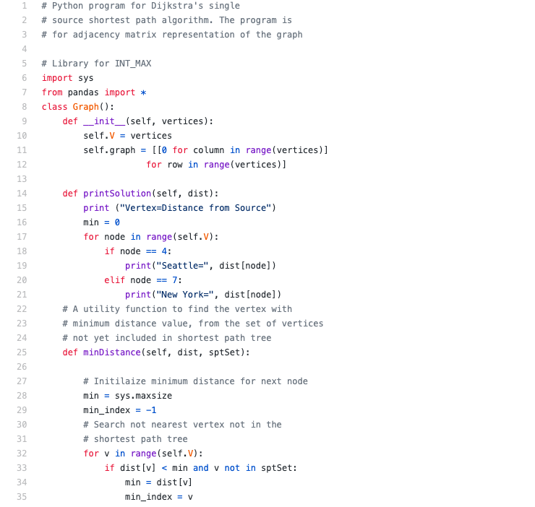
D. Python- Dijkstra's Algorithm Code
https://github.com/william8siew/CMGCaseStudy

Slide 20
Sources
https://www.mrbox.co.uk/shipping-containers/#:~:text=Standard%20ISO%20shipping%20containers%20are,ft%20(2.89m)%20high
https://flatiron.com

